Slide 1
DANA 4840
Classification II
Part III Hierarchical Clustering
Part 2 – Ward’s hierarchical clustering

Slide 2
Recall various algorithms to split data
Ways to Split Data
Partitional Hierarchical
K-means K-medoids Agglomerative Divisive
Single linkage Complete linkage Average linkage Ward’s method
(nearest neighbour) (furthest neighbour)

Slide 3
Agglomerative Hierarchical clustering:
Single linkage tends to produce long, “loose” clusters.
Students to draw a diagram to illustrate:
Complete linkage tends to produce more compact clusters.
Students to draw a diagram to illustrate:

Slide 4
Agglomerative Hierarchical clustering:
Ward’s linkage:
also called Ward’s minimum variance method
it minimizes the total within-cluster sum of squares
it tends to create clusters that are similar in size
like other hierarchical methods, Ward’s linkage is suitable for small datasets
Ward’s method can be implemented using Lance-Williams algorithm.

Slide 5
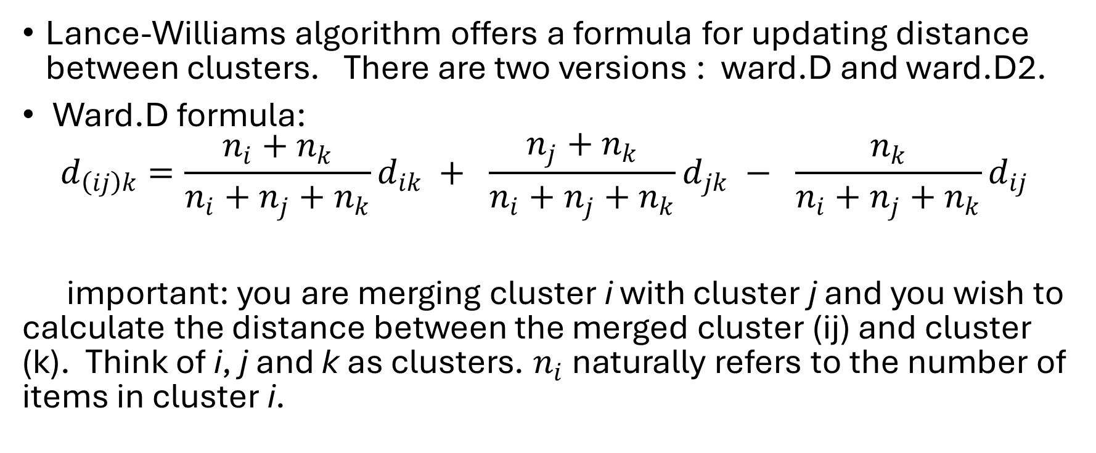
Lance-Williams algorithm:
Lance-Williams algorithm offers a formula for updating distance between clusters. There are two versions : ward.D and ward.D2.
Ward.D formula:
$$d_{\left(ij\right)k}=\frac{n_{i}+n_{k}}{n_{i}+n_{j}+n_{k}}d_{ik} + \frac{n_{j}+n_{k}}{n_{i}+n_{j}+n_{k}}d_{jk} − \frac{n_{k}}{n_{i}+n_{j}+n_{k}}d_{ij}$$
important: you are merging cluster i with cluster j and you wish to calculate the distance between the merged cluster (ij) and cluster (k). Think of i, j and k as clusters. $n_{i}$ naturally refers to the number of items in cluster i.

Slide 6
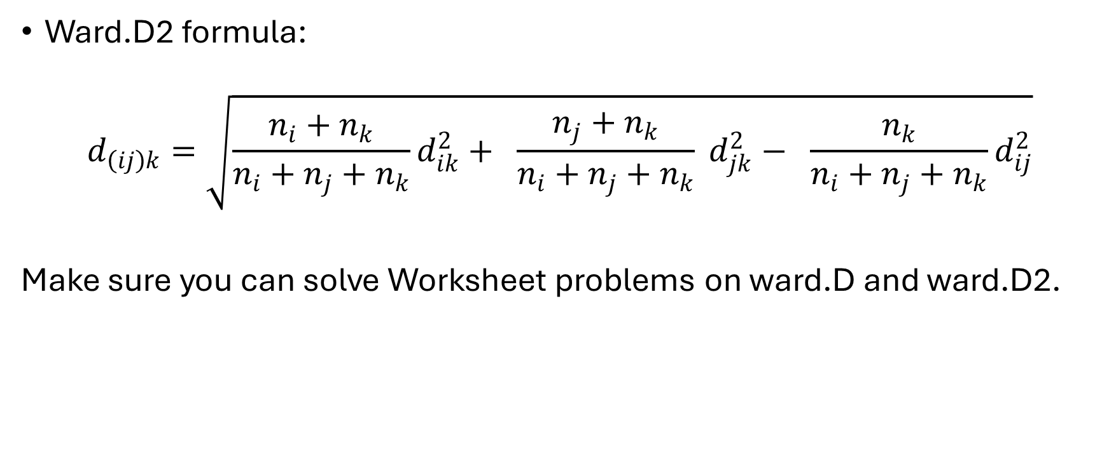
Lance-Williams algorithm:
Ward.D2 formula:
$$d_{\left(ij\right)k}=\sqrt{\frac{n_{i}+n_{k}}{n_{i}+n_{j}+n_{k}}d_{ik}^{2}+ \frac{n_{j}+n_{k}}{n_{i}+n_{j}+n_{k}} d_{jk}^{2}− \frac{n_{k}}{n_{i}+n_{j}+n_{k}}d_{ij}^{2}}$$
Make sure you can solve Worksheet problems on ward.D and ward.D2.

Slide 7
R code
Perform hierarchical clustering using ward.D:
- res.hc<-hclust(d = res.dist, method = “ward.D”)
Go through the worksheets on ward.D and ward.D2 and implement them using R code to verify that your hand-drawn dendrogram and calculations of cophenetic distances are correct.

